Slide 1
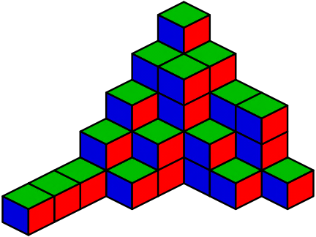

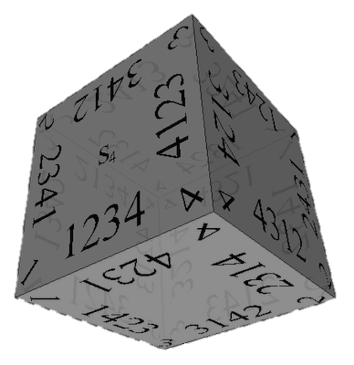


Combinatorics
Brief Overview of Combinations, Permutations and Binary Vectors
Data Structures and Algorithms
Telerik Software Academy
http://academy.telerik.com

Slide 2

Table of Contents
Definitions in Combinatorics
Permutations
Combinations
Pascal's Triangle
Binary Vectors
Resources

Slide 3
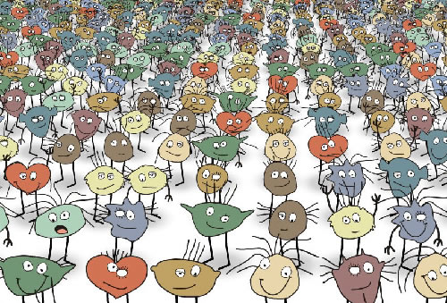
Definitions in Combinatorics

Slide 4
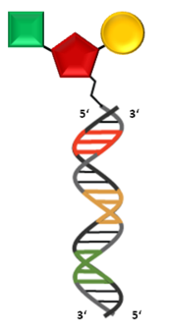

Combinatorics
Combinatorics is a branch of mathematics
Concerning the study of finite or countable discrete structures
Combinatorial problems arise in many areas of pure mathematics
Notably in algebra, probability theory, topology, geometry, physics, chemistry, biology, etc.

Slide 5
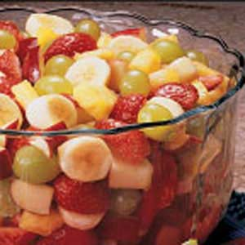
Combinations
"My fruit salad is a combination of grapes, strawberries and bananas"
We don't care what order the fruits are in
"bananas, grapes and strawberries" or "grapes, bananas and strawberries" → it is the same salad
If the order doesn't matter, it is a combination

Slide 6
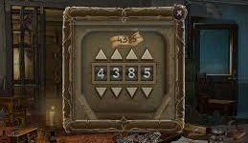
Permutations / Variations
"The combination to the safe is 4385".
Now we do care about the order
"8453" would not work, nor would "4538"
It has to be exactly 4-3-8-5
If the order does matter it is a permutation / variation
A permutation / variation is an ordered Combination
Easy to remember: "Permutation ... Position"

Slide 7


Factorial
The factorial function (!) just means to multiply a series of descending natural numbers
n! = n × (n-1)!
1! = 1, 0! = 1
4! = 4 × 3 × 2 × 1 = 24
7! = 7 × 6 × 5 × 4 × 3 × 2 × 1 = 5040

Slide 8
Factorial - Source code
Factorial – recursive
static long Factorial(int n)
{
if (n == 0) return 1;
return Factorial(n - 1) * n;
}
Factorial – iterative
static long Factorial(int n)
{
long result = 1;
for(int i = 2; i <= n; i++)
result = result * i;
return result;
}

Slide 9
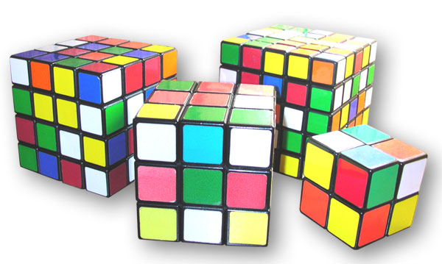
Variations

Slide 10
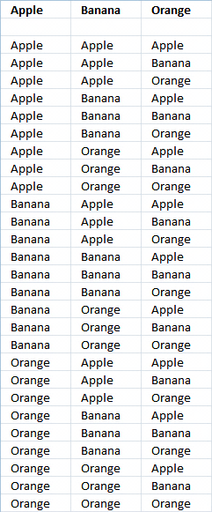
Variations
Variations (with repetitions)
Easiest to calculate
When you have n things to choose from ... you have n choices each time!
When choosing k of them, the variations are:
n × n × ... × n (k times)
n^{k}

Slide 11
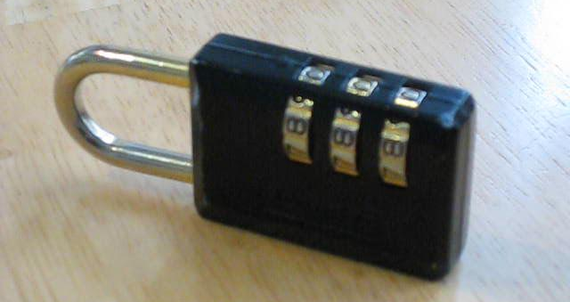
Variations (2)
Example: in the lock below, there are 10 numbers to choose from (0, 1, … 9) and you choose 3 of them:
10 × 10 × 10 (3 times) = 10³ = 1 000 variations
All variations from (0, 0, 0) to (9, 9, 9)

Slide 12

Generating Variations
static void Main()
{
GenerateVariations(0);
}
static void GenerateVariations(int index)
{
if (index >= k)
Print(arr);
else
for (int i = 0; i < n; i++)
{
arr[index] = i;
GenerateVariations(index + 1);
}
}

Slide 13
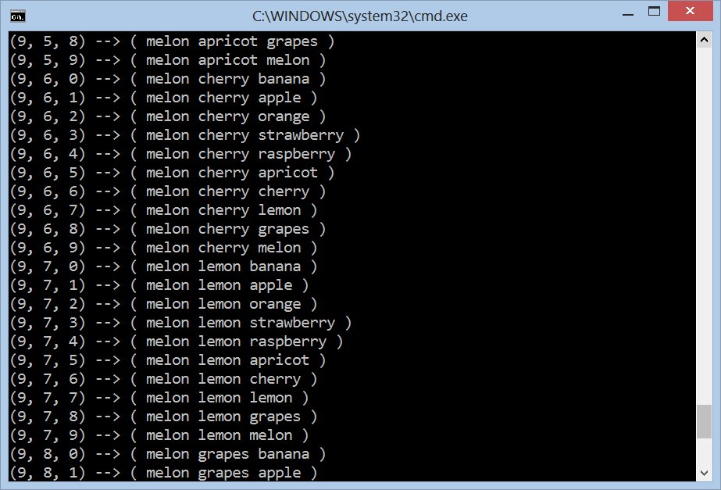
Variations with Repetitions
Live Demo

Slide 14
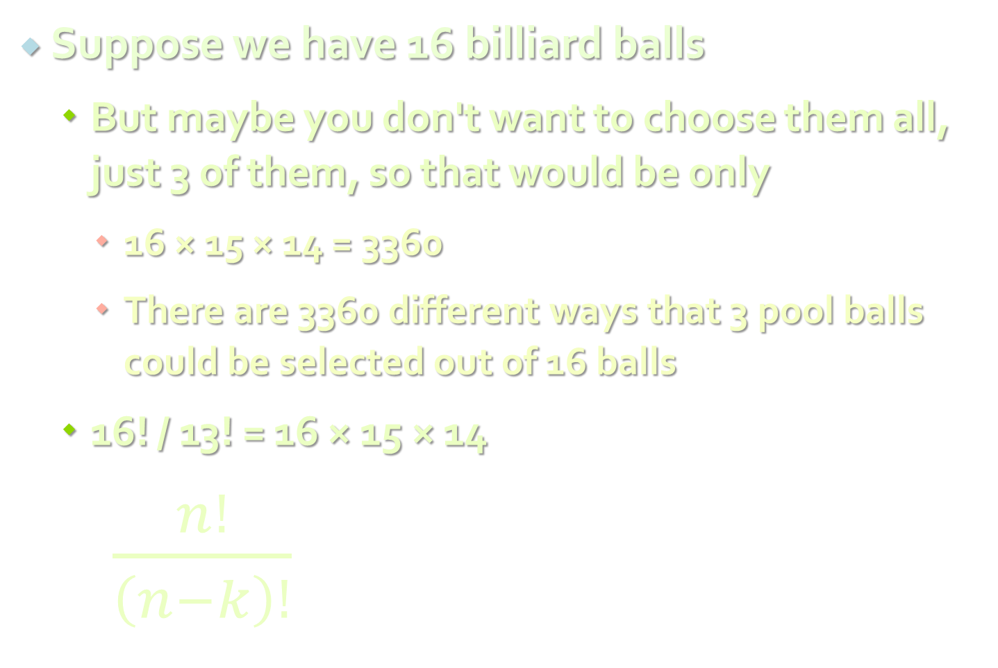
Variations without Repetition
Suppose we have 16 billiard balls
But maybe you don't want to choose them all, just 3 of them, so that would be only
16 × 15 × 14 = 3360
There are 3360 different ways that 3 pool balls could be selected out of 16 balls
16! / 13! = 16 × 15 × 14
$\frac{n!}{\left(n−k\right)!}$
where n is the number of things to choose from, and you choose k of them (No repetition, order matters)

Slide 15

Variations without Repetition
Example:
How many words of 2 different letters can you make with 4 letters { a, b, c, d }?
How to generate variations without repetitions?
The same way like variations with repetitions
Just use each element at most once
ab, ac, ad, ba, bc, bd, ca, cb, cd, da, db, dc

Slide 16

Generating Variations without Repetitions
static void GenerateVariationsNoReps(int index)
{
if (index >= k)
PrintVariations();
else
for (int i = 0; i < n; i++)
if (!used[i])
{
used[i] = true;
arr[index] = i;
GenerateVariationsNoReps(index + 1);
used[i] = false;
}
}
GenerateVariationsNoReps(0);

Slide 17
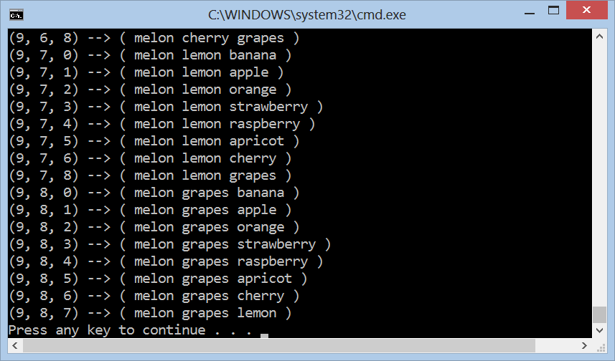
Variations without Repetitions
Live Demo

Slide 18

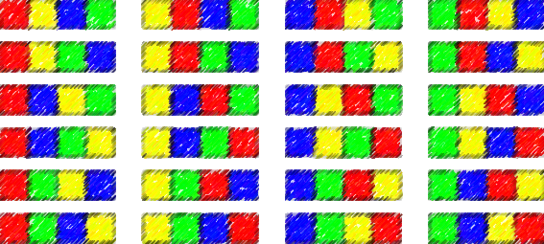

Permutations

Slide 19
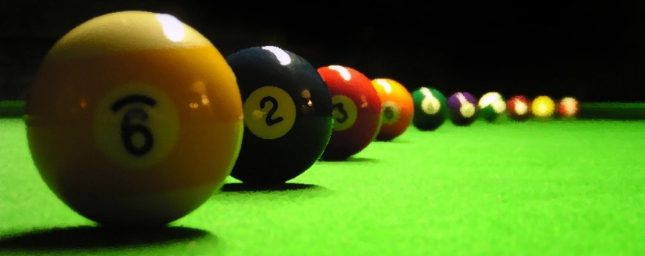
Permutations
Less number of available choices each time
What order could 16 pool balls be in?
After choosing, ball 9 we can't choose the same ball again
First choice = 16 possibilities
Second choice = 15 possibilities, etc., etc.
Total permutations:
16 × 15 × 14 ×...× 2 × 1 = 16! = 20 922 789 888 000

Slide 20

Generating Permutations
static void Perm<T>(T[] arr, int k)
{
if (k >= arr.Length)
Print(arr);
else
{
Perm(arr, k + 1);
for (int i = k + 1; i < arr.Length; i++)
{
Swap(ref arr[k], ref arr[i]);
Perm(arr, k + 1);
Swap(ref arr[k], ref arr[i]);
}
}
}

Slide 21
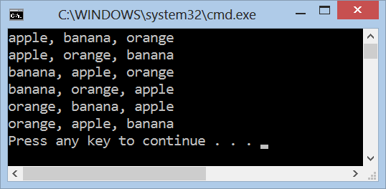
Generating Permutations
Live Demo

Slide 22
Permutations with Repetitions
We have a set of elements, with repetitions
E. g. set = { 3, 5, 1, 5, 5 }
We want to generate all unique permutations (without duplicates):
{ 1, 3, 5, 5, 5 } { 1, 5, 3, 5, 5 } { 1, 5, 5, 3, 5 } { 1, 5, 5, 5, 3 }
{ 3, 1, 5, 5, 5 } { 3, 5, 1, 5, 5 } { 3, 5, 5, 1, 5 } { 3, 5, 5, 5, 1 }
{ 5, 1, 3, 5, 5 } { 5, 1, 5, 3, 5 } { 5, 1, 5, 5, 3 } { 5, 3, 1, 5, 5 }
{ 5, 3, 5, 1, 5 } { 5, 3, 5, 5, 1 } { 5, 5, 1, 3, 5 } { 5, 5, 1, 5, 3 }
{ 5, 5, 3, 1, 5 } { 5, 5, 3, 5, 1 } { 5, 5, 5, 1, 3 } { 5, 5, 5, 3, 1 }
We want to efficiently avoid the repeating ones, i.e. to work fast for { 1, 5, 5, 5, 5, 5, 5, 5, 5, 5, 5, 5, 5, 5, 5, 5, 5, 5}

Slide 23
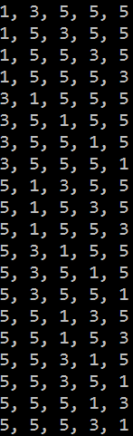
Generating Permutations with Repetitions
var arr = new int[] { 3, 5, 1, 5, 5 };
Array.Sort(arr);
PermuteRep(arr, 0, arr.Length);
static void PermuteRep(int[] arr, int start, int n)
{
Print(arr);
for (int left = n - 2; left >= start; left--)
{
for (int right = left + 1; right < n; right++)
if (arr[left] != arr[right])
{
Swap(ref arr[left], ref arr[right]);
PermuteRep(arr, left + 1, n);
}
var firstElement = arr[left];
for (int i = left; i < n - 1; i++)
arr[i] = arr[i + 1];
arr[n - 1] = firstElement;
}
}

Slide 24
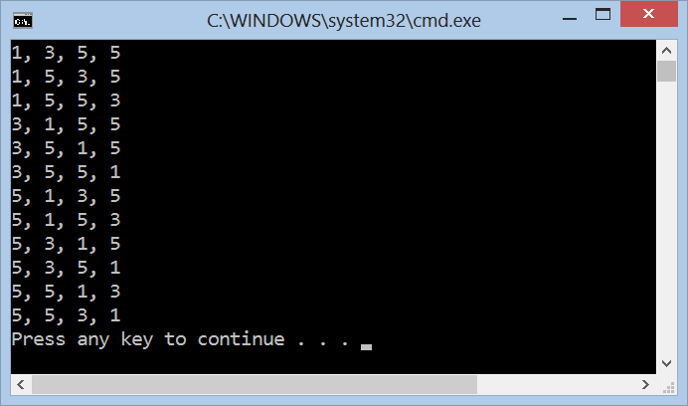
Generating Permutations with Repetitions
Live Demo

Slide 25
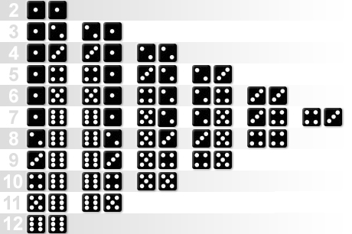
Combinations

Slide 26
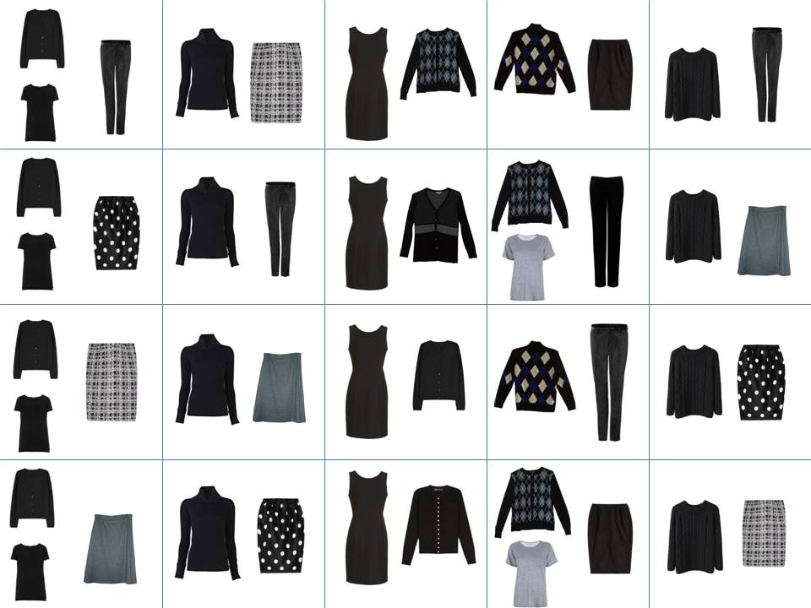
Combinations
Order does not matter!
Two types of combinations:
Repetition is allowed
Coins in your pocket
5,5,20,20,20,10,10
No repetition
Lottery numbers
TOTO 6/49, 6/42, 5/35
2,14,15,27,30,33

Slide 27
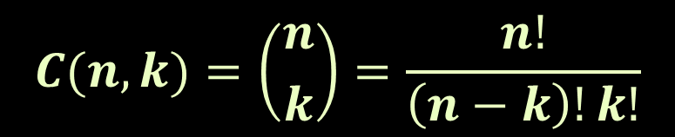
Combinations without Repetition
Back to the 3 of 16 billiard balls
Many comb. will be the same
We don't care about the order
Permutations w/o repetitions reduced by how many ways the objects could be in order:
This is how lotteries work (TOTO 6/49)
Often called "n choose k" (Google it!)
Order does matter | Order doesn't matter
1 2 3 1 3 2 2 1 3 2 3 1 3 1 2 3 2 1 | 1 2 3
$$C(n, k)=\left({n \atop k}\right)=\frac{n!}{\left(n−k\right)!k!}$$

Slide 28

Generate Combinations without Repetitions
static void Main()
{
Comb(0, 0);
}
static void Comb(int index, int start)
{
if (index >= k)
PrintCombinations();
else
for (int i = start; i < n; i++)
{
arr[index] = i;
Comb(index + 1, i + 1);
}
}

Slide 29
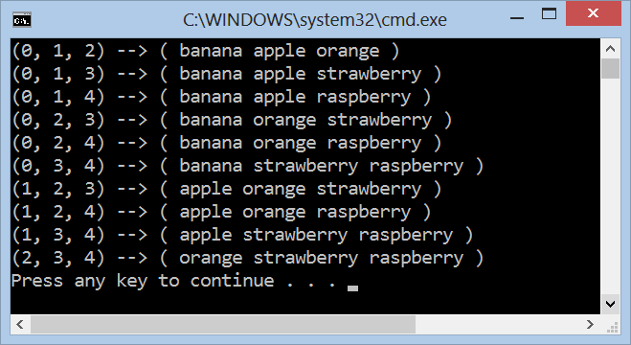
Combinations without Repetitions
Live Demo

Slide 30
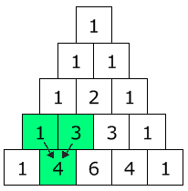

Pascal's Triangle
The Pascal's triangle shows you how many combinations of objects without repetition are possible
Go down to row "n" (the top row is 0)
Move along "k" places
The value there is your answer
Build the triangle: start with "1" at the top, then continue placing numbers below it in a triangular pattern
$$\left({n \atop k}\right)=\frac{n!}{\left(n−k\right)!k!}$$

Slide 31
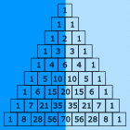
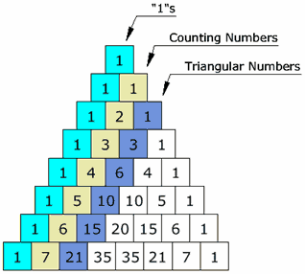
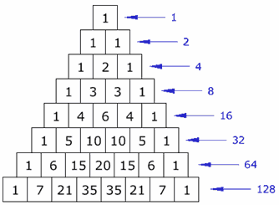
Pascal's Triangle's (2)
The triangle is symmetrical
Numbers on the left side have identical matching numbers on the right side, like a mirror image
Diagonals:
First diagonal – only “1”s
Second diagonal – 1, 2, 3, etc.
Third diagonal – triangular numbers
Horizontal sums: powers of 2

Slide 32

Binomial Coefficients
Calculate using recursion:
$$\left({n \atop k}\right)=\left({n−1 \atop k−1}\right)+\left({n−1 \atop k}\right)$$
static decimal Binom(int n, int k)
{ if (k > n) return 0;
else if (0 == k || k == n) return 1;
else return Binom(n-1, k-1) + Binom(n-1, k);
}
Calculate using dynamic programming:
decimal m[MAX], i, j;
for (i = 0; i <= n; i++) {
m[i] = 1;
if (i > 1) {
if (k < i - 1) j = k; else j = i - 1;
for (; j >= 1; j--) m[j] += m[j - 1];
}
} // The answer is in m[k]

Slide 33
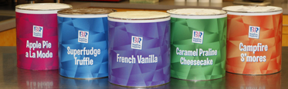
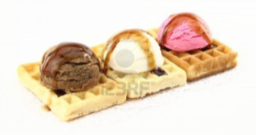
Combinations with Repetition
Ice-cream example
5 flavors of ice-cream: banana, chocolate, lemon, strawberry and vanilla
3 scoops
How many combinations will there be?
Let's use letters for the flavors: {b, c, l, s, v}
{c, c, c} (3 scoops of chocolate)
{b, l, v} (one each of banana, lemon and vanilla)
{b, v, v} (one of banana, two of vanilla)

Slide 34

Combinations with Repetition
Ice-cream example
n=5 things to choose from, choose k=3 of them
Order does not matter, and we can repeat
Think about the ice cream being in boxes
arrow means move, circle means scoop
{c, c, c} (3 scoops of chocolate)
{b, l, v} (banana, lemon, vanilla)
{b, v, v} (banana, two of vanilla)

Slide 35
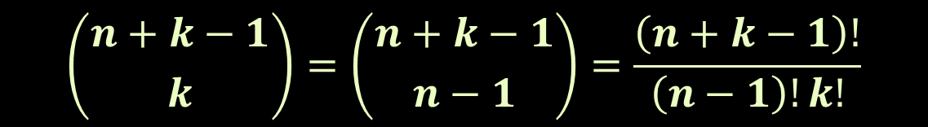
Combinations with Repetition
We have a simpler problem to solve
How many different ways can you arrange arrows and circles?
3 circles (3 scoops) and 4 arrows (we need to move 4 times to go from the 1st to 5th container)
There are k + (n-1) positions, and we want to choose k of them to have circles
$$\left({n+k−1 \atop k}\right)=\left({n+k−1 \atop n−1}\right)=\frac{\left(n+k−1\right)!}{\left(n−1\right)!k!}$$

Slide 36

Generate Combinations with Repetitions
static void Main()
{
Comb(0, 0);
}
static void CombReps(int index, int start)
{
if (index >= k)
PrintVariations();
else
for (int i = start; i < n; i++)
{
arr[index] = i;
CombReps(index + 1, i);
}
}

Slide 37
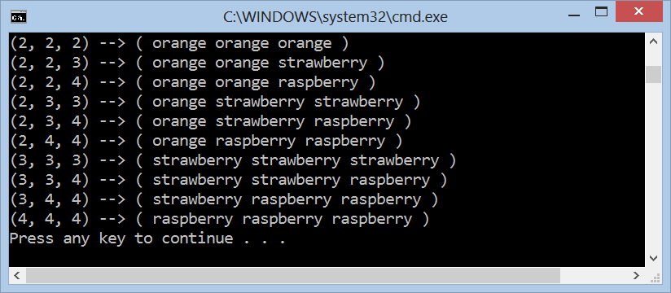
Generating Combinations with Repetitions
Live Demo

Slide 38
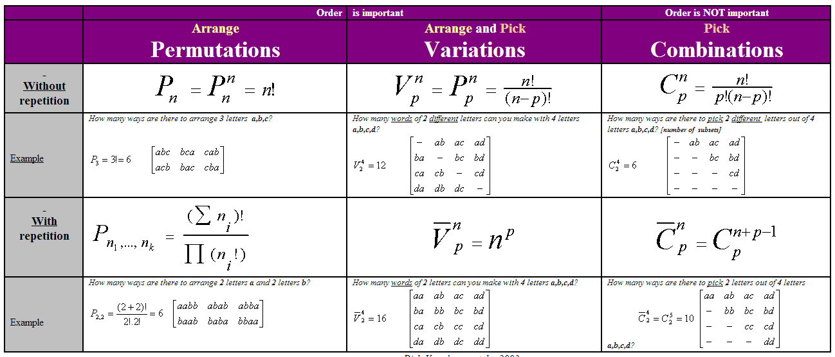
Combinatorial Formulas
Calculating the number of permutations, variations, combinations
Use the well known formulas:
Source: http://users.telenet.be/vdmoortel/dirk/Maths/PermVarComb.html

Slide 39
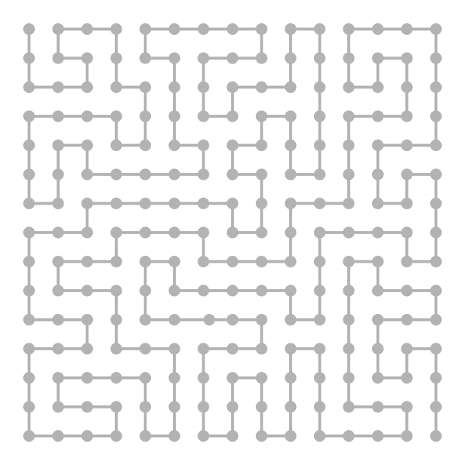
Binary Vectors

Slide 40
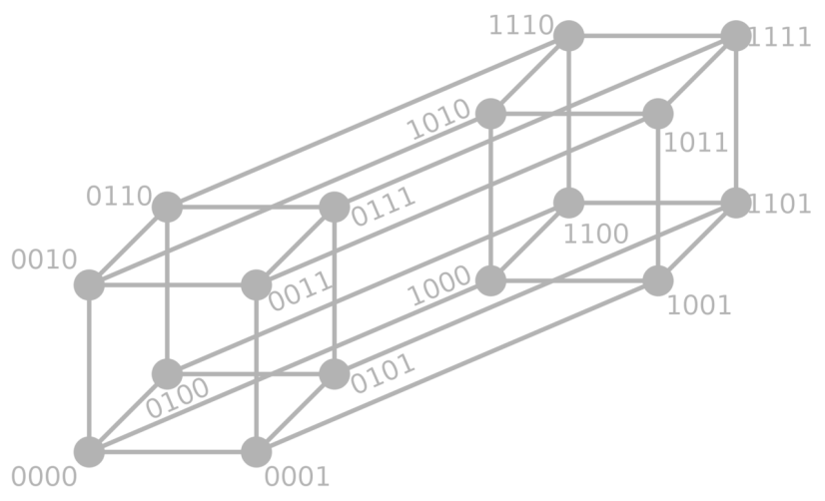
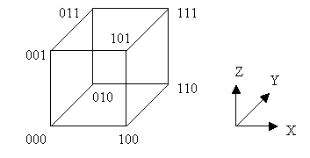
Binary Vectors
Some problems can be reformulated in terms of binary vectors – (1, 0, 1, 1, 1, 0, …)
Combinatorial properties of binary vectors:
Number of binary vectors of length n: 2^{n}.
Number of binary vectors of length n and with k `1` is C(n, k) (we choose k positions for n `1`)

Slide 41
Gray Code
Gray code (a.k.a. reflected binary code) is a binary numeral system where two successive values differ by only one bit
Gray code by bit width
2-bit | 4-bit
00 01 11 10 | 0000 0001 0011 0010 0110 0111 0101 0100 1100 1101 1111 1110 1010 1011 1001 1000
3-bit
000 001 011 010 110 111 101 100
Decimal | Gray | Binary
0 | 000 | 000
1 | 001 | 001
2 | 011 | 010
3 | 010 | 011
4 | 110 | 100
5 | 111 | 101
6 | 101 | 110
7 | 100 | 111

Slide 42

Gray Code – Source Code
static int n = 4, a[1000], i;
static void Print()
{ for (i = n; i >= 1; i--) Console.Write("{0} ", a[i]);
Console.WriteLine();
}
static void Backgray(int k)
{ if (0 == k) { Print(); return; }
a[k] = 1; Forwgray(k - 1);
a[k] = 0; Backgray(k - 1);
}
static void Forwgray(int k)
{ if (0 == k) { Print(); return; }
a[k] = 0; Forwgray(k - 1);
a[k] = 1; Backgray(k - 1);
}
static int Main() { Forwgray(n); return 0; }

Slide 43
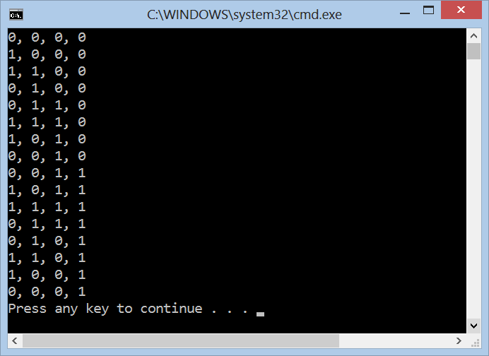
Gray Code
Live Demo

Slide 44
Resources
Video lectures (in Bulgarian)
http://cs.maycamp.com/?page_id=685
http://cs.maycamp.com/?page_id=760
http://cs.maycamp.com/?page_id=764
TopCoder article: http://goo.gl/bN9RL
http://en.wikipedia.org/wiki/Permutation
http://en.wikipedia.org/wiki/Combination
Book: http://goo.gl/Z2Knl
Nakov’s book: Programming = ++Algorithms;

Slide 45
Combinatorics
http://algoacademy.telerik.com

Slide 46
Exercises
Solve 2 problems by choice from Algo Academy (October 2012 – Combinatorics): http://academy.telerik.com/algoacademy/season-2012-2013/training-27-28-Oct-2012-combinatorics
You may test your solutions in BG Coder: http://bgcoder.com/Contest/Practice/59

Slide 47




Free Trainings @ Telerik Academy
C# Programming @ Telerik Academy
csharpfundamentals.telerik.com
Telerik Software Academy
academy.telerik.com
Telerik Academy @ Facebook
facebook.com/TelerikAcademy
Telerik Software Academy Forums
forums.academy.telerik.com

